Slide 1
PROJECT NAME: CHURN RATE PREDICTION:
MENTORS::
BHANUPRIYA MA’AM
HARSHAL SIR
TEAM MEMBERS:
DINESH
YASHAS
VIDDYASAGAR
KAVYA
ROHIT
MONCY

Slide 2

BUSINESS OBJECTIVE:
To predict whether a customer is going to cancel the booking or not.
This project that will try to predict whether a booking by a customer will be cancelled or not using machine learning / deep learning models based on historical data.

Slide 3
CHURN RATE:
Churn rate is defined as the rate at which individual/customers leave a group/subscription over a specified period.
In the most general sense, it is referred to as the proportion of subscribed customers who terminate their contractual relationship (i.e., subscription) with a company over a given timeframe
Churn rate can be applied to subscription-based businesses as well as to the number of employees that leave a firm
A high churn rate could adversely affect profits and impede growth. Advantages of calculating a company’s churn rate is that it provides clarity on how well the business is retaining its customers.
The churn rate will indicate to a company that it needs to understand why its clients are leaving and where to fix its business. The cost of acquiring new customers is higher than it is to retain existing customers.

Slide 4

PROJECT GOAL
The Goals of this project is to find out the characteristic
of customers who cancelled and finding a pattern in
cancelled booking by exploratory data analysis.
Building model to predict cancellation.
Create a dashboard and deploy the model
using flask/streamlit etc from our machine learning or
deep learning algorithm, that can predict of
cancellation based on user input.

Slide 5
WORK FLOW
Collect the data from given data set
Data cleaning
Exploratory Data Analysis (EDA)
Model Evaluation
Model selection
Modeling
Model Deployment and Result

Slide 6

THINGS TO DO IN EDA
How many booking were cancelled?
What is the booking ratio between Resort Hotel
and City Hotel?
What is the percentage of booking for each year?
From which country most guests come?
How long People stay in the hotel?
Which was the most booked accommodation
type(Single,Couple,Family)?

Slide 7

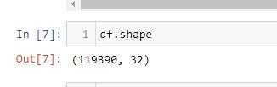
DATA SET DETAILS AND OBSERVATIONS
This data was acquired by extraction from hotel’s property management system from 2015 to 2017.
This data set contains booking information for a city hotel and a resort hotel, and includes information such as when the booking was made, length of stay, the number of adults, children, and/or babies, and the number of available parking spaces,etc
Quick Observation:
This data set contains 119390 rows and 32 columns.
Target Variable = is_canceled
‘is_canceled’ consists of 2 values -
0: booking not canceled
1: booking canceled

Slide 8
A summary of insights
Between the years 2015 to 2017, we can observe around 35-38% cancellations.
If a customer booked a long time ago with respect to his arrival date, there are more chances that they will cancel their booking.
If a customer is on the waitlist for a longer period of time, they are more likely to cancel the booking.
Majority of the bookings were by the customers residing in Portugal.
Months of July and August were the busiest for all the hotels.
Customers who booked for the first time, tend to cancel their bookings more as compared to repeated guests.
If a customer did not a make a deposit while booking, they were more likely to cancel the booking.

Slide 9
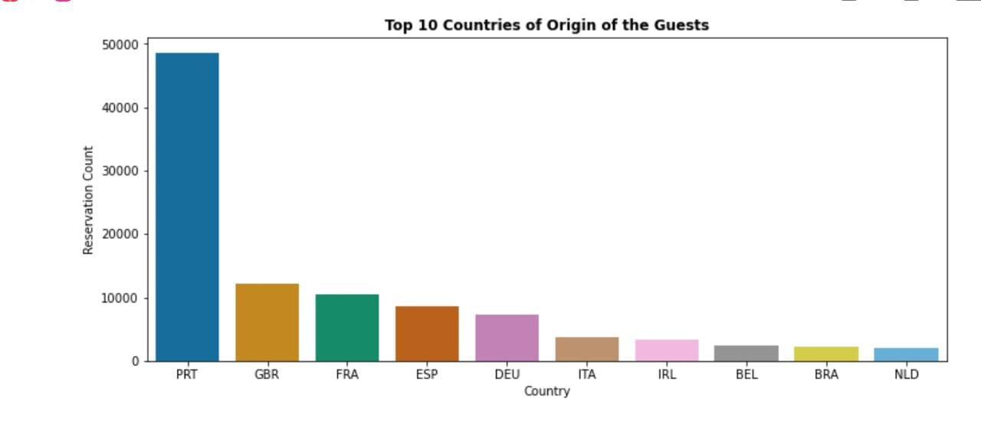
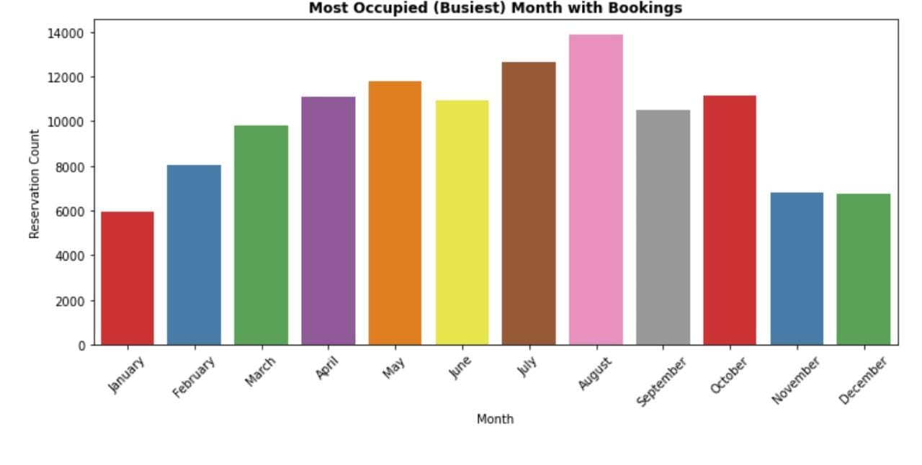
Data Insights and Visualizations
The top 5 countries from where the most bookings were done are:
Portugal
UK
France
Spain
Germany
August was the busiest month for all the hotel types.
Next busiest month was july.

Slide 10
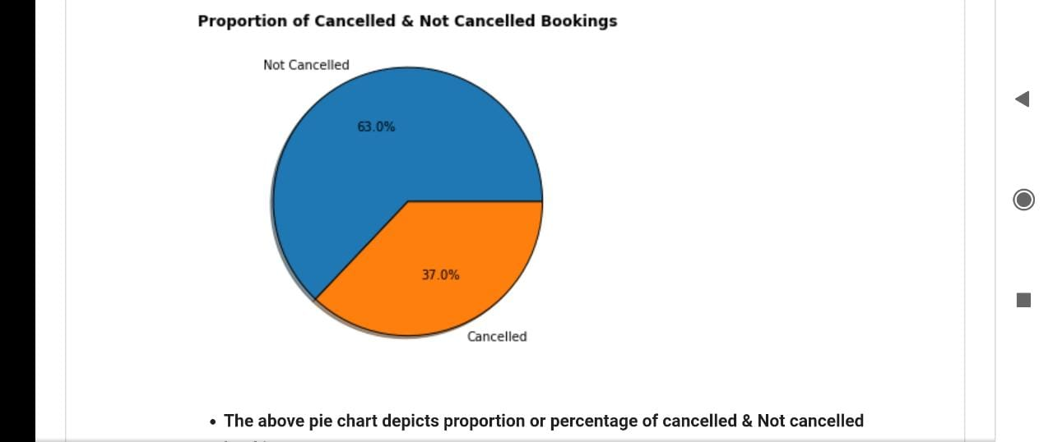
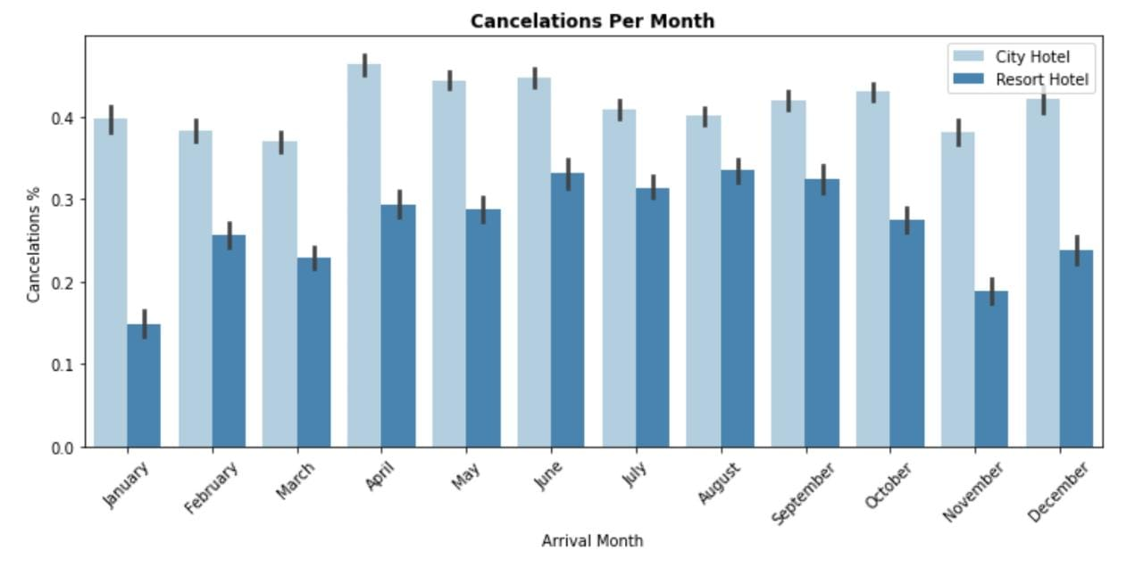
Data Insights and Visualizations
There were about 37% overall cancellations between the three years.
For city hotels, April to June and December experienced the most cancellations.
For resort hotels, June to September experienced the most cancellations.

Slide 11
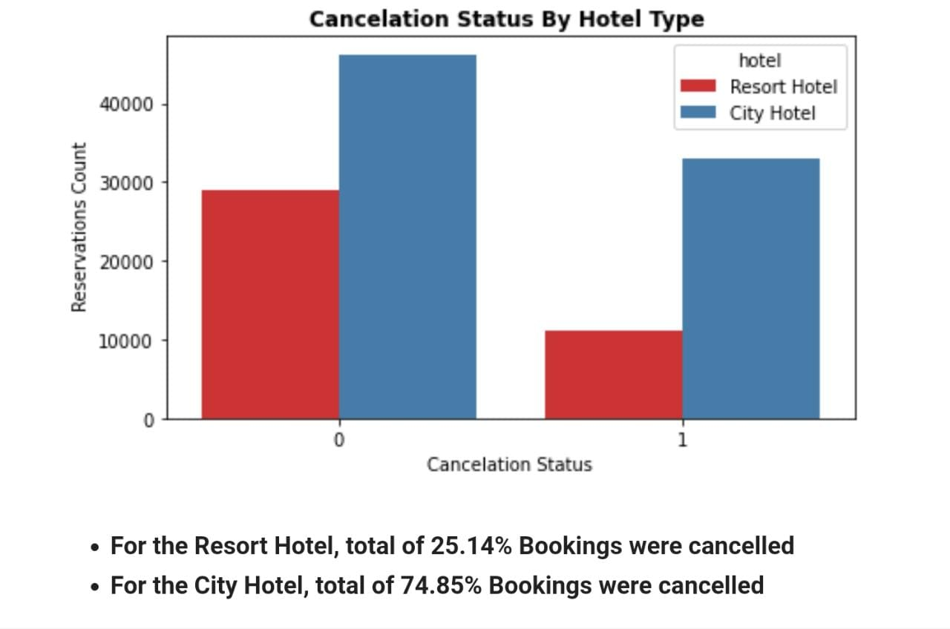
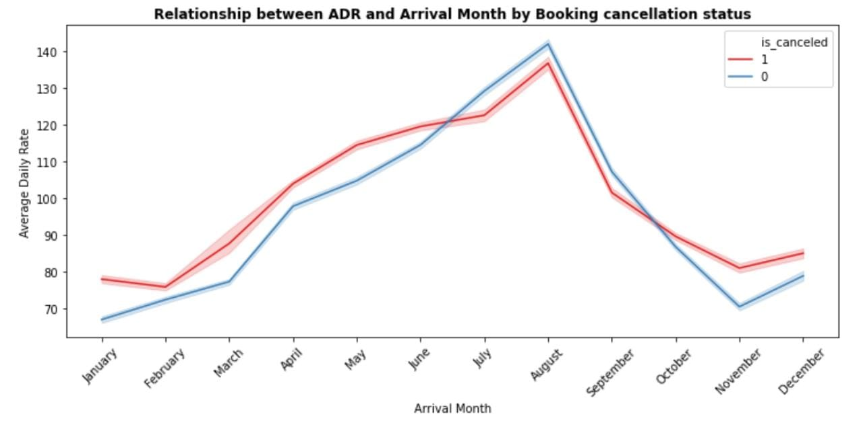
Data Insights and Visualizations
City hotels overall experienced more cancellations than resort hotels, around 75%.
The above line chart depicts arrival month August is the most occupied month of bookings
The highest ADR has been occurred in same August month
Due to highest ADR in August may be it could be one of the reasons for more cancelled bookings in August.

Slide 12
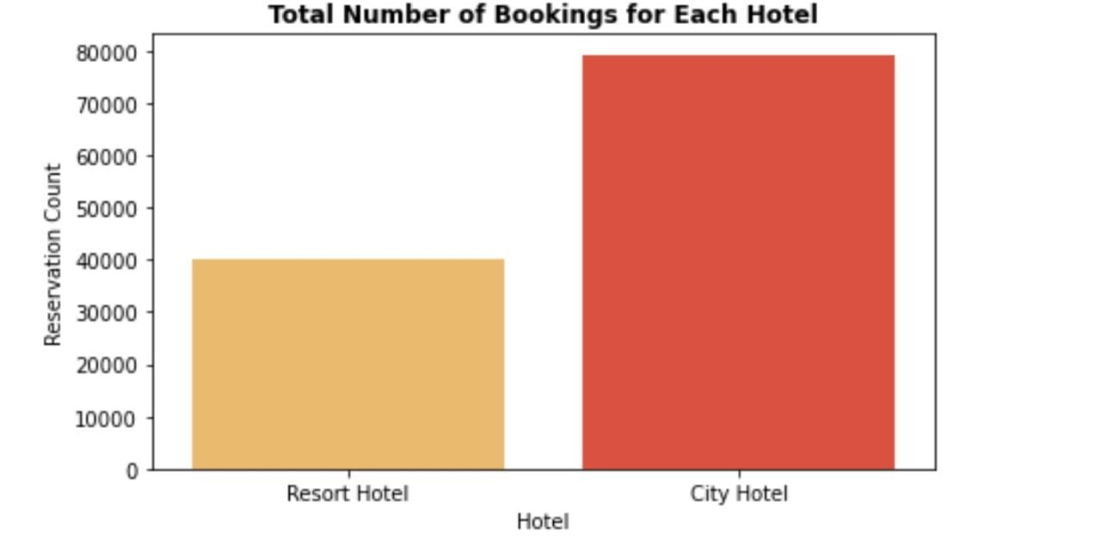
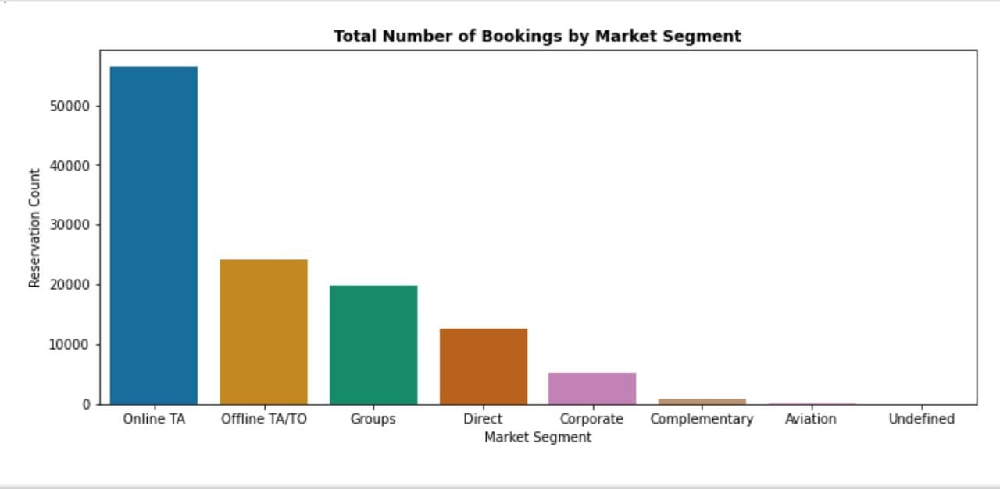
Data Insights and Visualizations
There are about ~78,000 city hotel bookings as opposed to ~40,000 resort hotel bookings.
Online TA(Travel Agents) were the major source of bookings.
The next major source of bookings were done by local TA/TO (Travel Agent/Tour Operators).

Slide 13
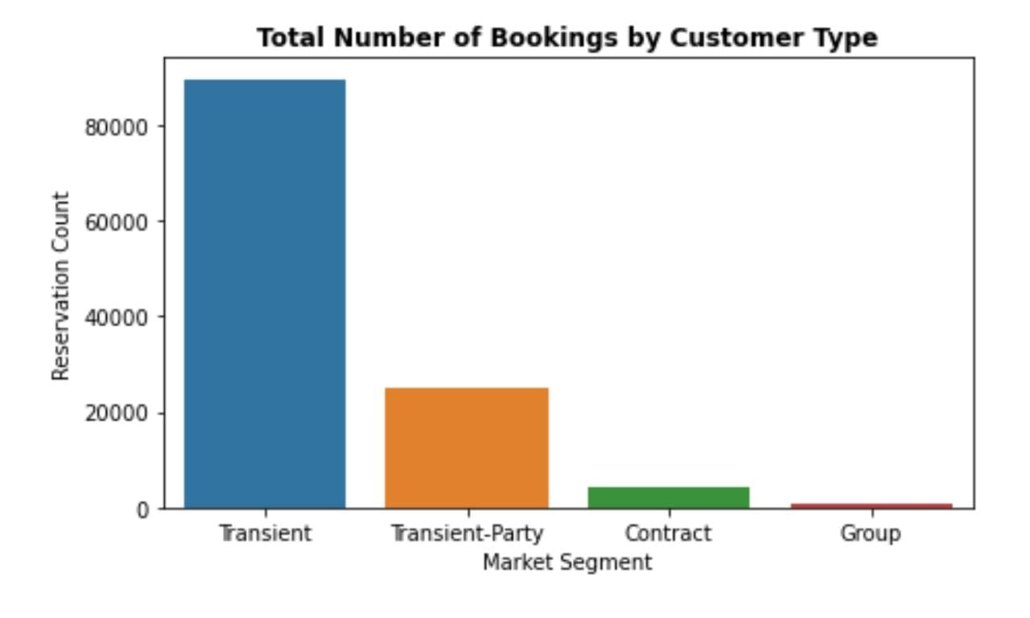
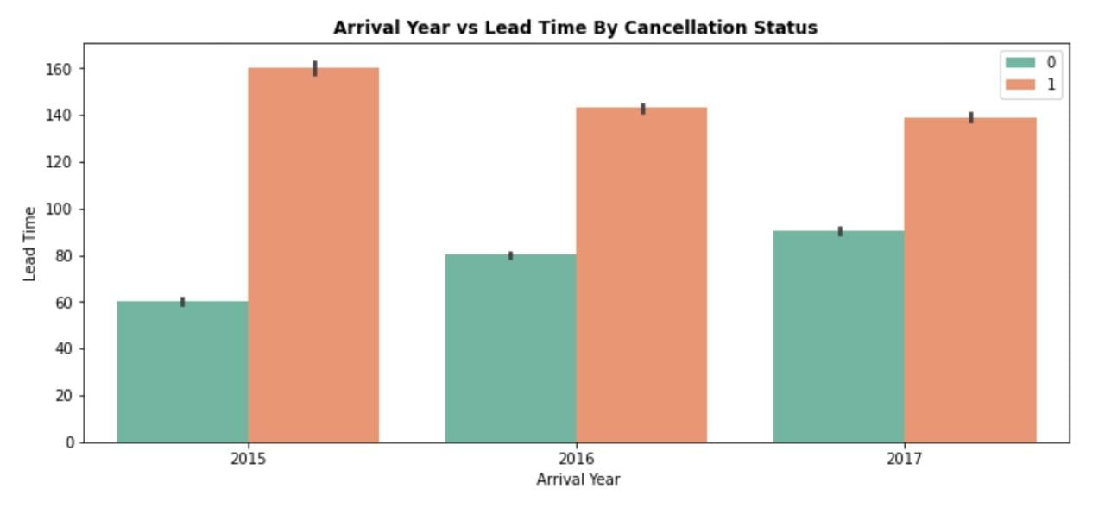
Data Insights and Visualizations
Transient Customer type were the major customers of hotels.
Transient customers can be generalized into those who stay for a short period of time, do their bookings at the last moment.
The pattern we observe here is that when the lead time(time between the booking date and actual arrival date) is more, a customer is more likely to cancel the booking. It can be clearly seen that in 2015 there were more cancellations due to a longer lead time!

Slide 14
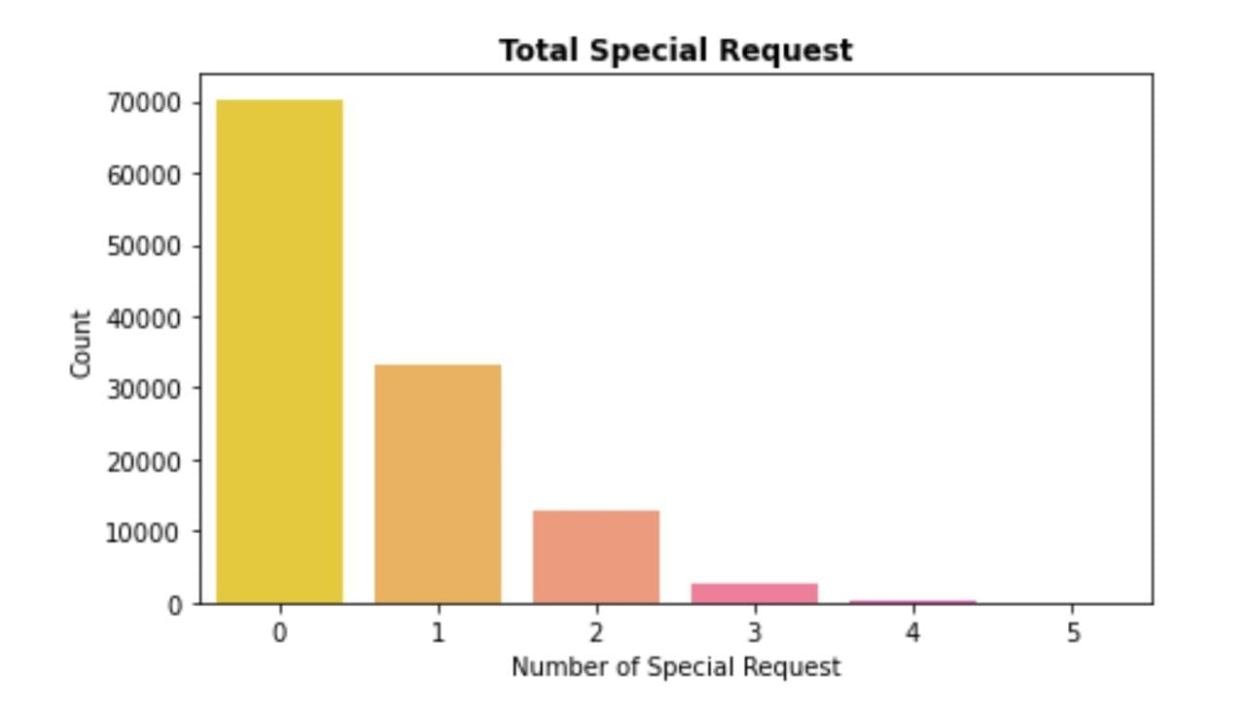
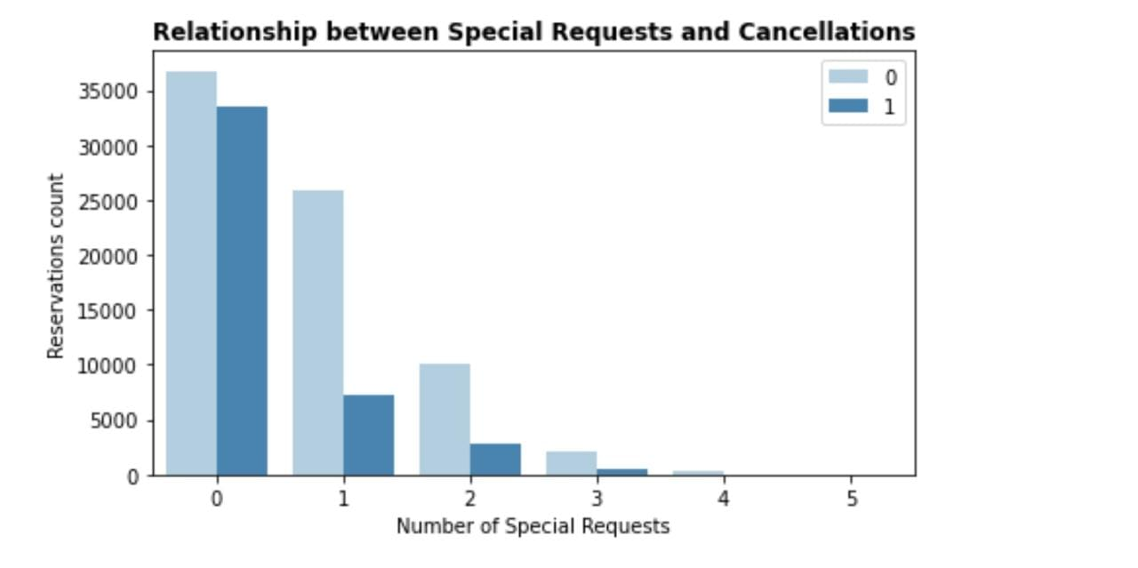
Data Insights and Visualizations
Most of the customers opted for no special requests.
There’s a pattern emerging here. As the number of special request go up, the number of cancellations seem to go down.
This implies that the customers with the least special requests are inclined towards cancellation.

Slide 15
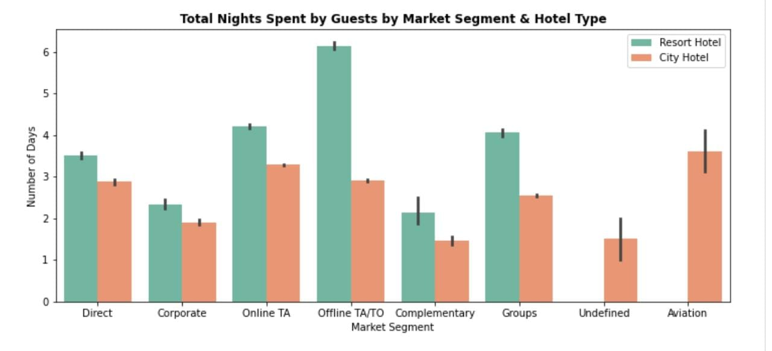
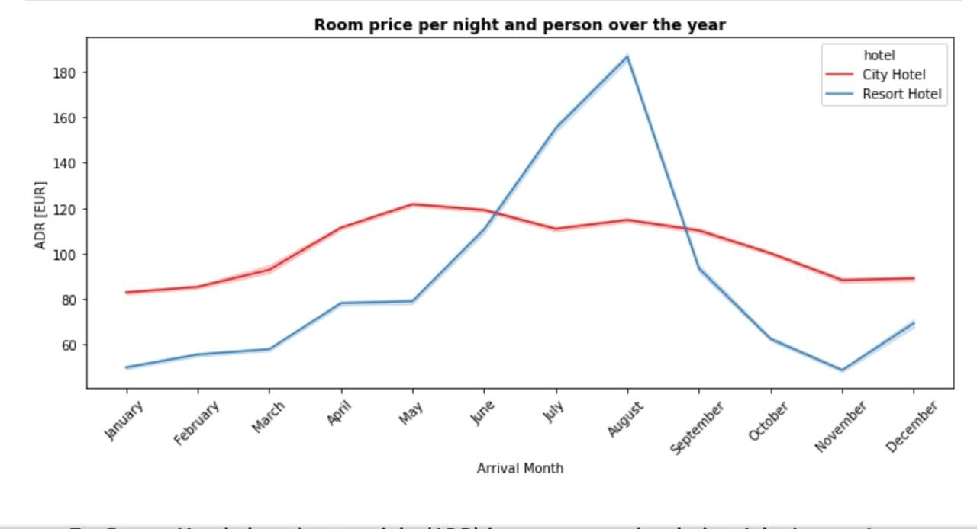
Data Insights and Visualizations
Customers tend to stay longer in resort hotels compared to city hotels.
The customers who booked via a local TO/TA tend to stay longer in a resort hotel than a city hotel!
The room price per night for city hotels did not fluctuate much reaching a peak in the month of may, which was also one of their busiest month.
A different story for resort hotels, where we can see a spike going July and August and then rapidly coming done towards the year end.

Slide 16
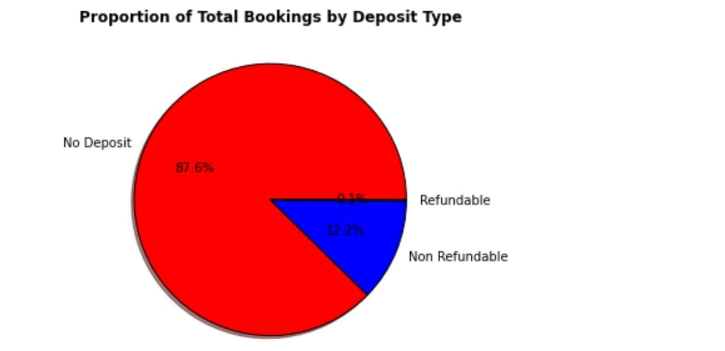
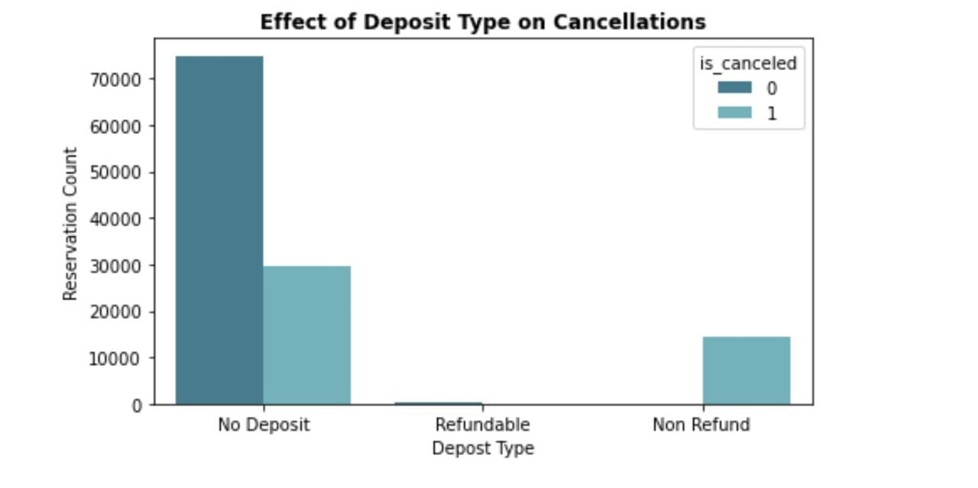
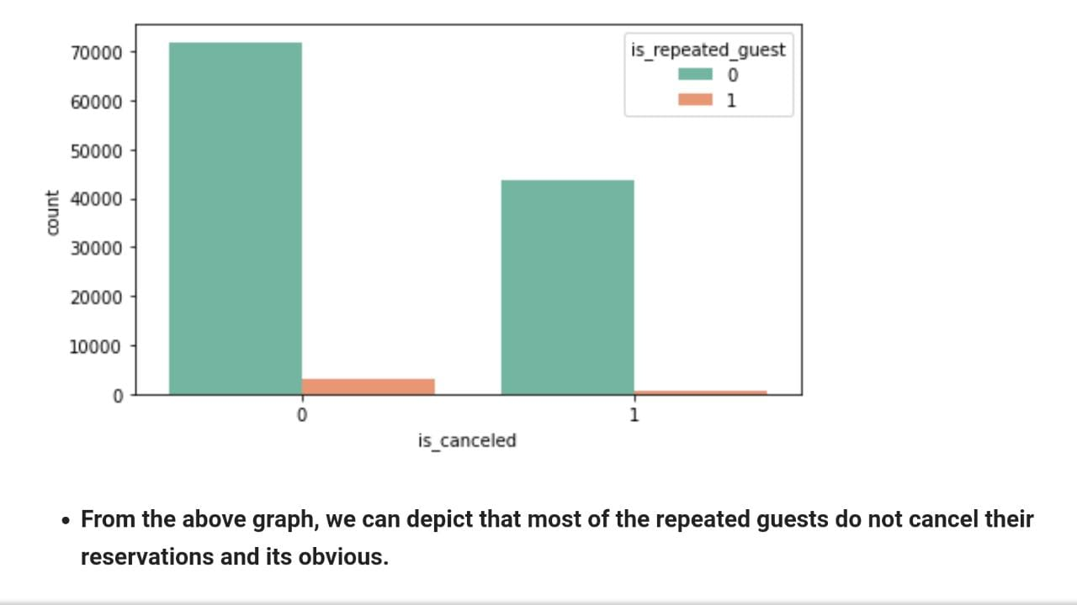
Data Insights and Visualizations
Majority of customers did not make a deposit.
Also, customers who did not make a deposit were also the ones who cancelled their bookings more.
It can be clearly seen that first-time customers were a major contributors to the cancellations.

Slide 17
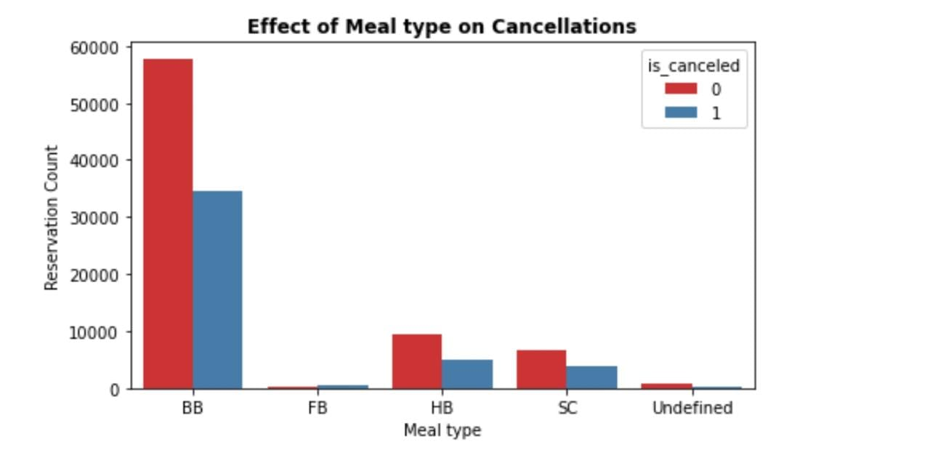
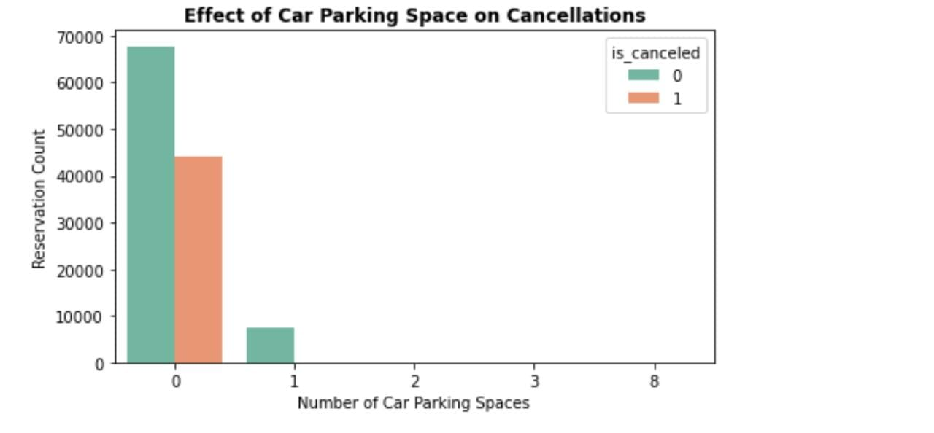
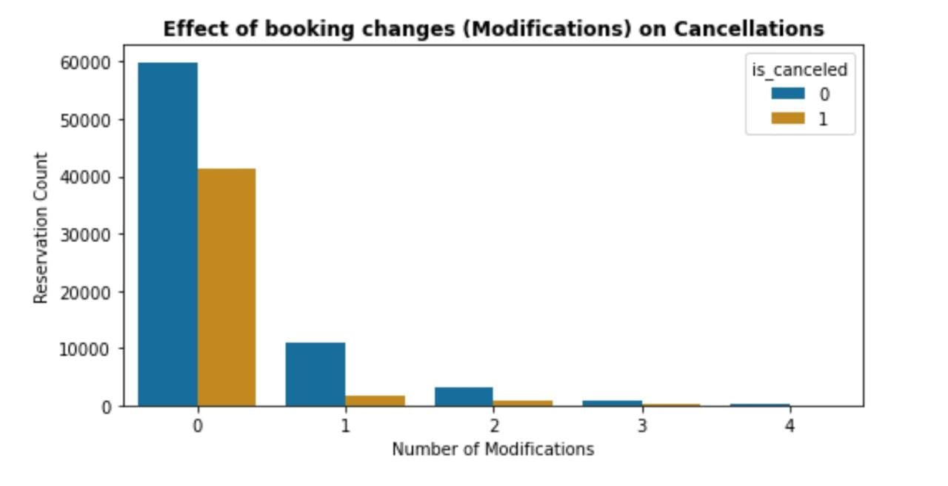
Data Insights and Visualizations
Bed and Breakfast(BB) meal type was the most commonly opted.
Customers with BB meal option also had more cancellations.
Majority of customers didn’t opt for a parking spot.
Those who did, did not cancel their booking.
As the booking modifications went up, the number of cancellations came down.
Customers with no booking changes ended up with the most cancellations.

Slide 18
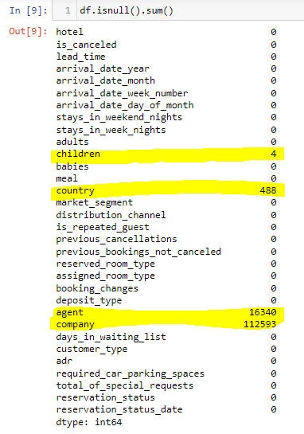
After doing basic analysis we observed null values are present in mainly 4 columns they are
1) children
2) country
3) agent
4) company
Handling Missing Values

Slide 19
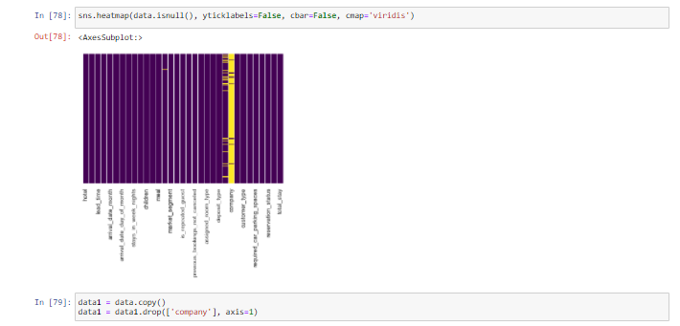
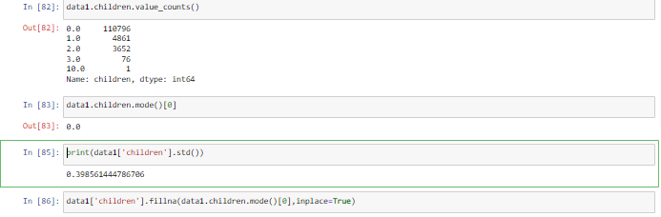
Handling Missing Values
Company column appears to have the most number of NA values as seen in the heatmap on the left.
So, instead of filling it with appropriate values, we go with dropping the whole column.
The children column has 4 NA values.
We find out which is the most occurring value using mode.
0 appears to be most occurring value, so we fill the NA values with 0.
We also convert the datatype of children column from Float64 to Int64.

Slide 20
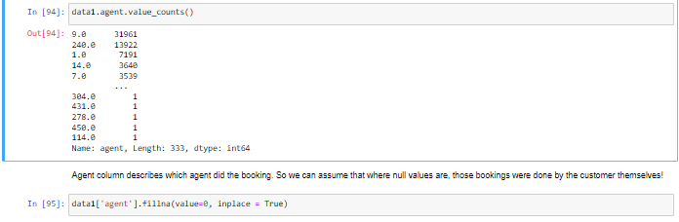
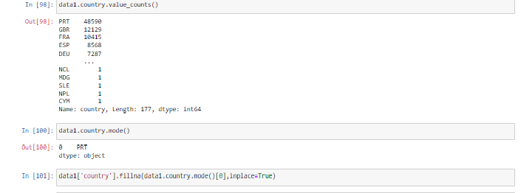
Handling Missing Values
Agent column has the most NA values after company column.
Each value presumably represents the Agent ID who did the booking.
Assuming that the NA values could represent that the customer themselves did the booking. So we can assign them a value of 0.
Thus replacing all the NA values with 0.
Country column has 488 NA values.
PRT is the most occurring value of this column.
So, we fill the NA values with the mode.

Slide 21
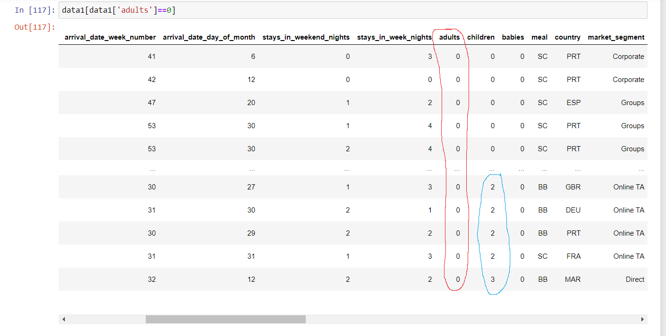
Working with the Data
An interesting observation here, some values in the Adult column appear to have 0 as a value.
Most of the corresponding Children and Babies values appear to be 0 but some of them have a value of 2 attached to them (seen within the blue marking).
Logically, a booking has to be done by an Adult. A child cannot book a room on their own.

Slide 22
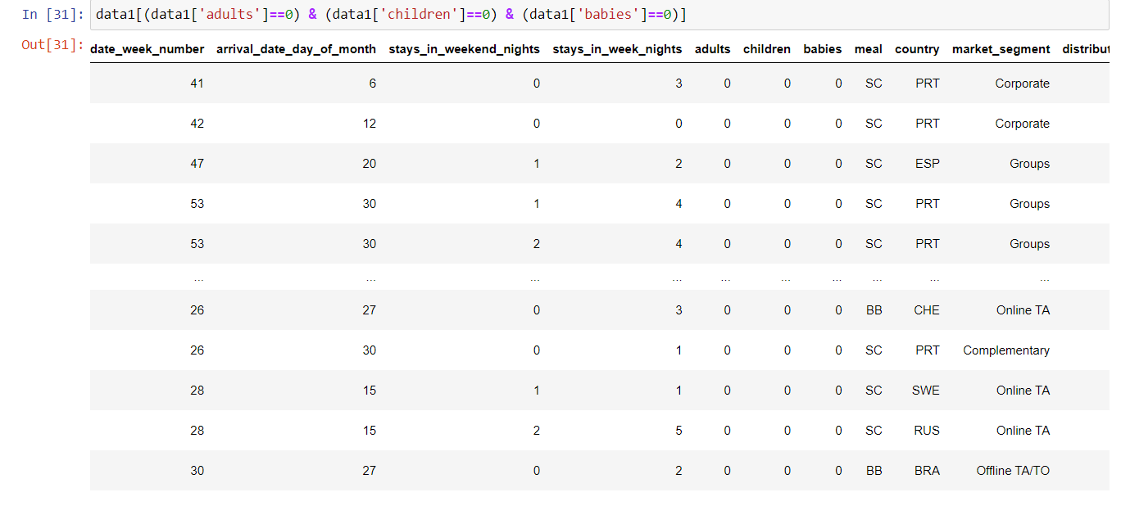
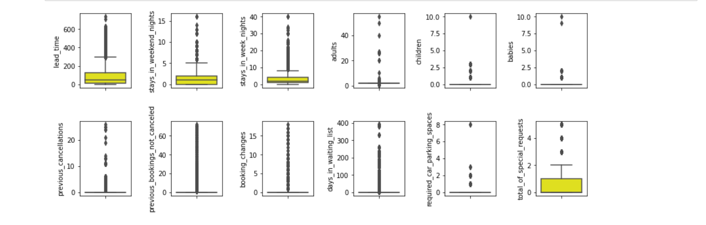
Outlier Handling
In the previous slide, we observed there were observations with ‘0’ as a value under the Adult column.
A quick look at the same data also shows that there are ‘0’ values under all the three columns Adults, Children, Babies which could mean an error in the dataset.
So, we remove these rows and we combine the three columns into a new category called ‘Guests’.
Almost all the features have several outliers as seen in the boxplot on the left.
We can treat outliers either by:
Using Standard Deviation
Z- Scores
IQR method

Slide 23
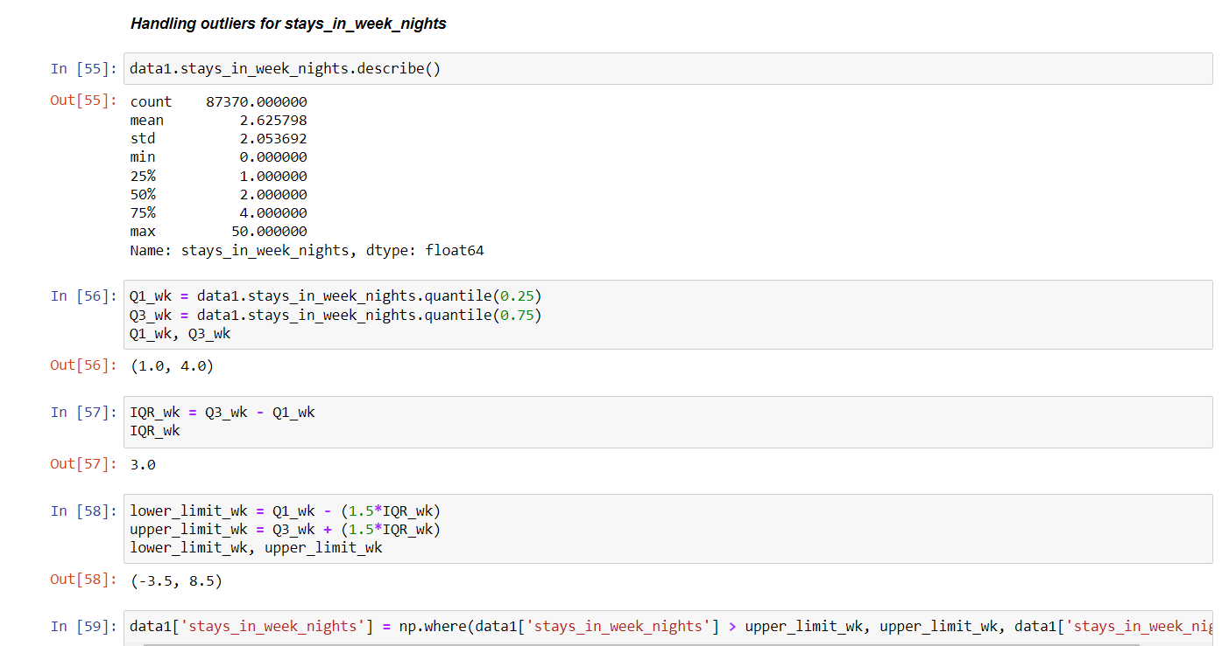
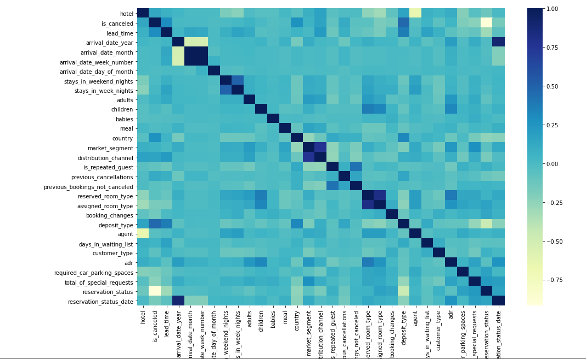
Outlier Handling
Feature Selection
An example of handling outliers using IQR method can be seen on the right.
In this case, we replace all the values that are above the upper limit (Q3 + 1.5*IQR) with the upper limit value.
As suggested, we divide our data into two sets based on the hotel types: City Hotel and Resort Hotels.
Using Correlation Matrix, we calculate the best features which we will use to build our model.
Reservation status seems to have the highest correlation with cancellation in the negative direction which could drastically affect it.
Arrival date, night stay columns won’t be considered because of low correlation.

Slide 24
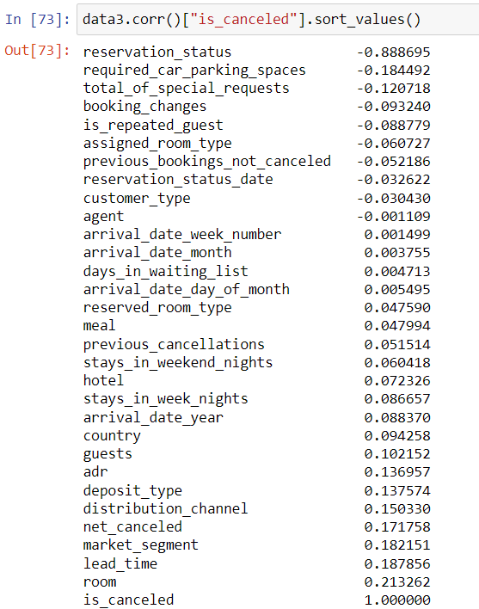
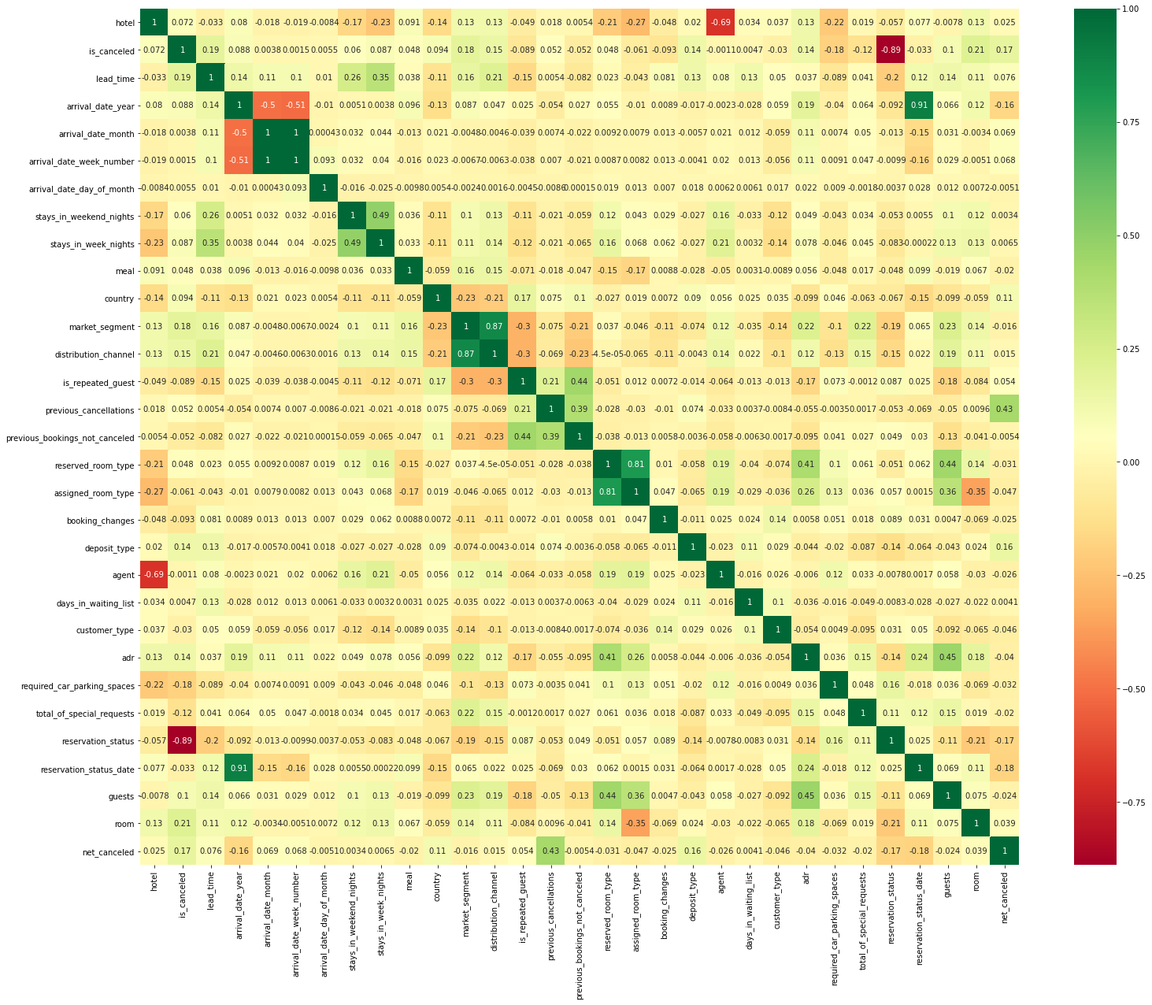
Model Building - Feature Selection

Slide 25
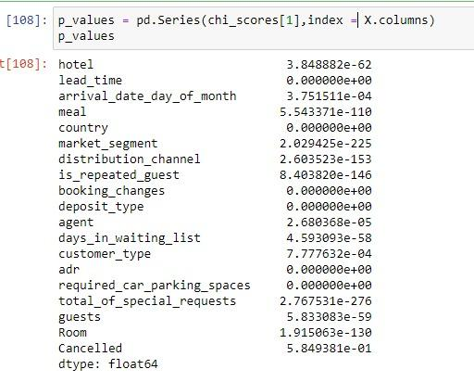
Model Building - Feature Selection
The Model building started with Feature Selection.
We label encoded the categorical features, merged columns together and performed an initial Correlation check using a correlation plot and Heatmap as shown in the previous slide.
To cross-check if our correlation values were correct, we verified them again by performing Chi2 test. The scores are presented to the left.
With the help of the two techniques, we were able to narrow our features down from 32 to 20 features.

Slide 26
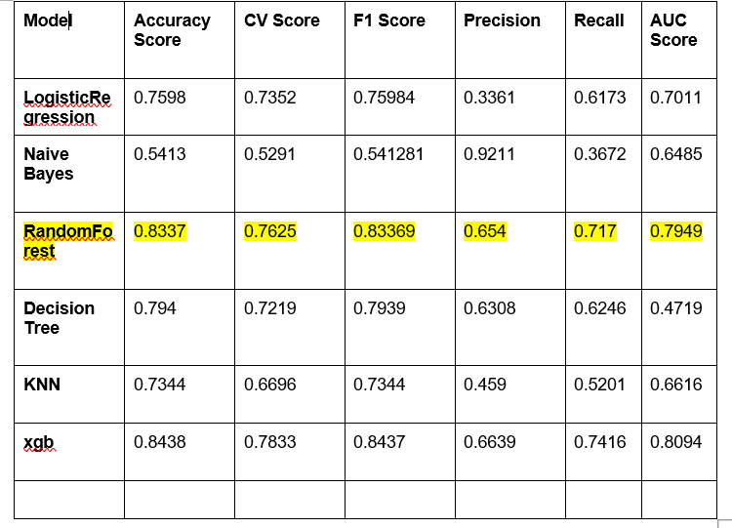
Model Building - Before Handling Dataset Imbalance
After feature selection, we did an initial run of models just to get a ballpark of how accurate they are!.
We split the data 70:30 into Train:Test for this estimate.
We tried various Classification models to check which one was better than the rest.
We observed XGBoost and Random Forest models came out with the best accuracy score, F1 score, Precision and Recall out of all the models.
Note: This is before handling the imbalance in our dataset

Slide 27
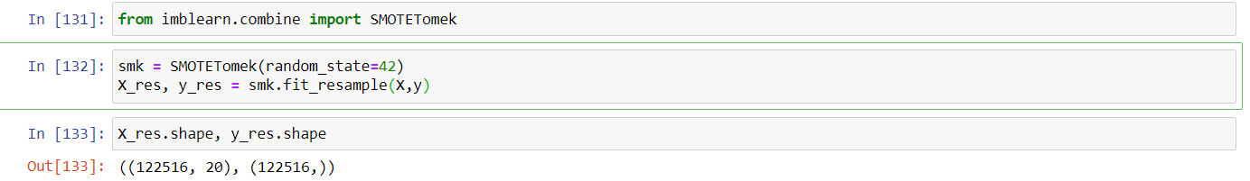
Model Building - Handling Dataset Imbalance
The dataset provided to us is imbalanced dataset, i.e there is a difference in value counts of majority class and minority class, as seen above.
There are various techniques to handle the imbalance namely. Undersampling, Oversampling, SMOTE (Synthetic Minority Over-sampling Technique), K-Means clustering etc.
We chose Oversampling to treat the imbalance in our dataset where it upsampled the minority class to match the majority class.
We used SMOTETomek from imblearn module to perform oversampling. The dataset thus looked like this. (We also used Random OverSampler to handle the imbalance)

Slide 28
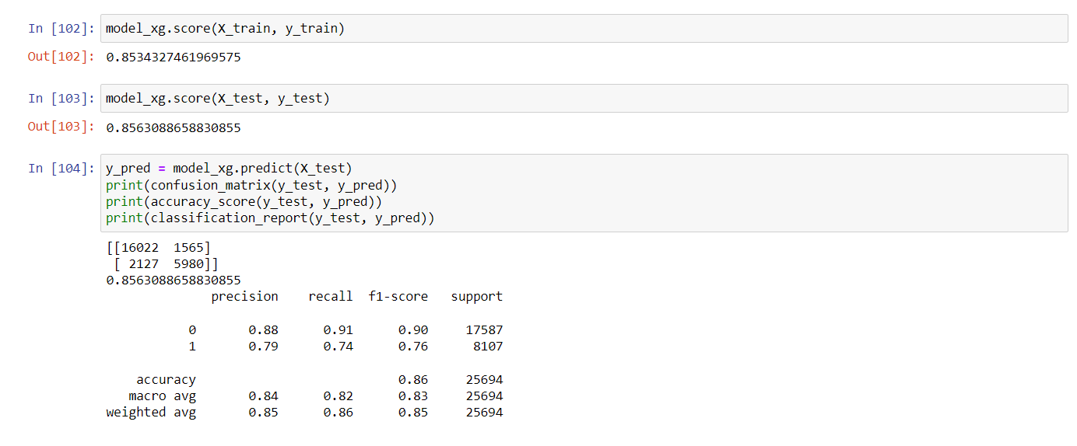
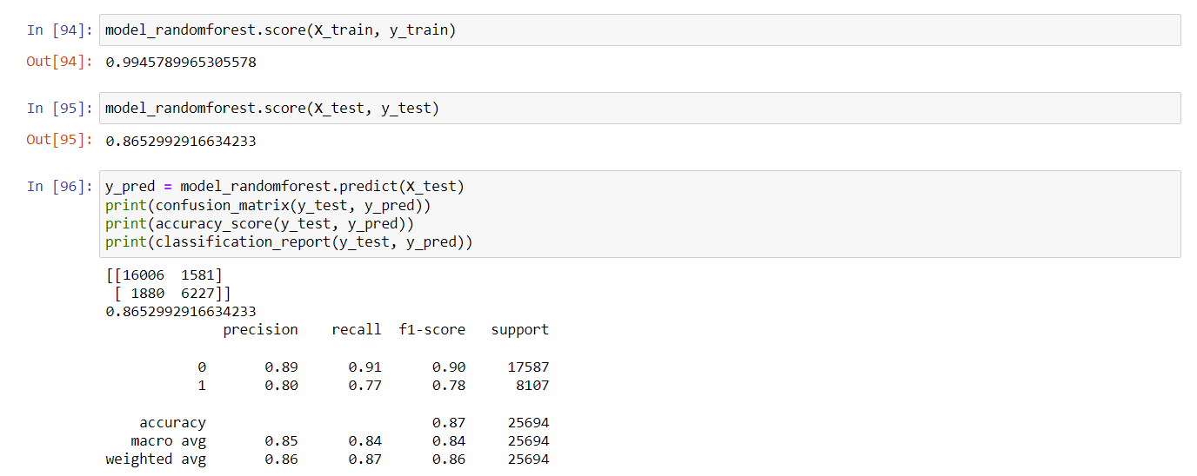
Model Building - With Balanced Dataset
Now with the dataset fully ready, we reran our models.
We used Logistic Regression, Naive Bayes, Random Forest, Decision Tree, KNN and XGBoost classification models.
The oversampled dataset was split into Test-Train in a 70:30 split.
For XGBoost, we got 85% accuracy for training and test set. Whereas for Random Forest, we got 99% accuracy for training set and 86% for test set.
With these scores in mind, we went forward with both XGBoost and Random Forest methods and performed hyperparameter tuning.

Slide 29
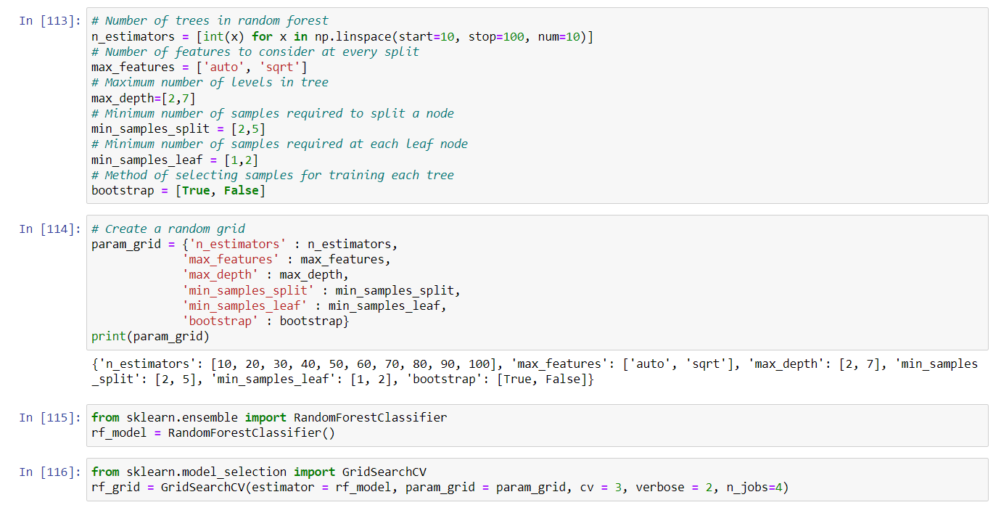
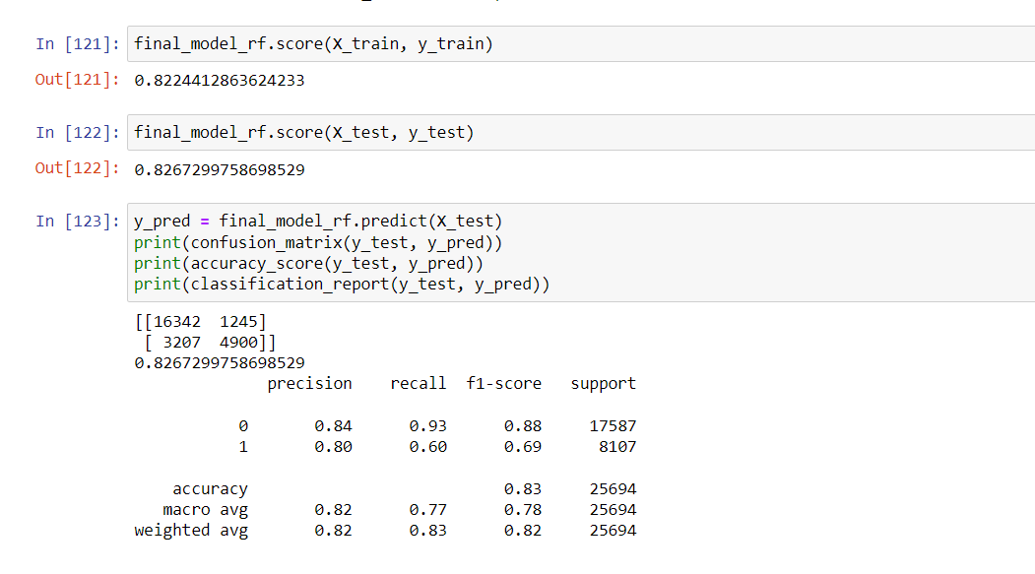
Random Forest Model Building - Hyperparameter Tuning
With GridSearchCV, we performed hyperparameter tuning on our Random Forest Classifier.
Initially some values were given to the model and the best parameters were figured out. The best parameters were used to fit the final model.
For training, the accuracy reduced to 82% and for test data we got around 83% accuracy.

Slide 30
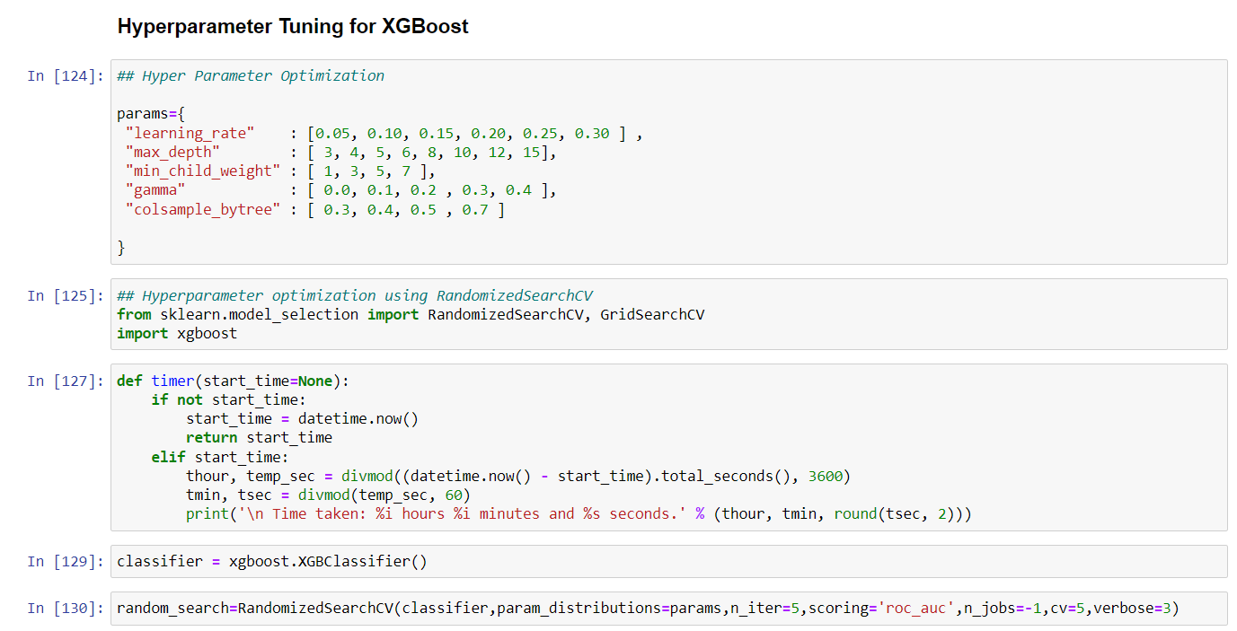
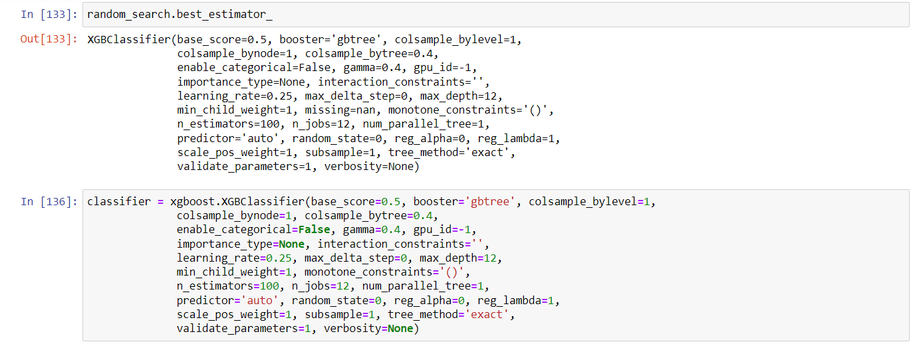
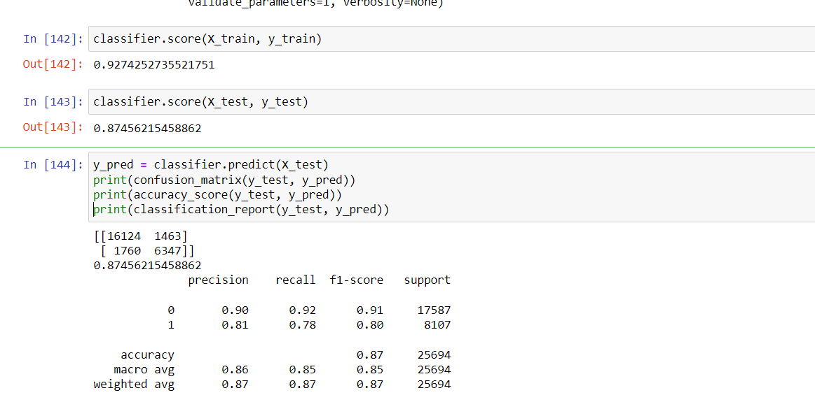
XGBoost Model Building - Hyperparameter Tuning
With RandomizedSearchCV , we performed hyperparameter tuning on our XGBoost model.
Initially some values were given to the model and the best parameters were figured out. The best parameters were used to fit the final model.
For training, the accuracy improved to 92.7% and for test data we got around 87% accuracy.

Slide 31
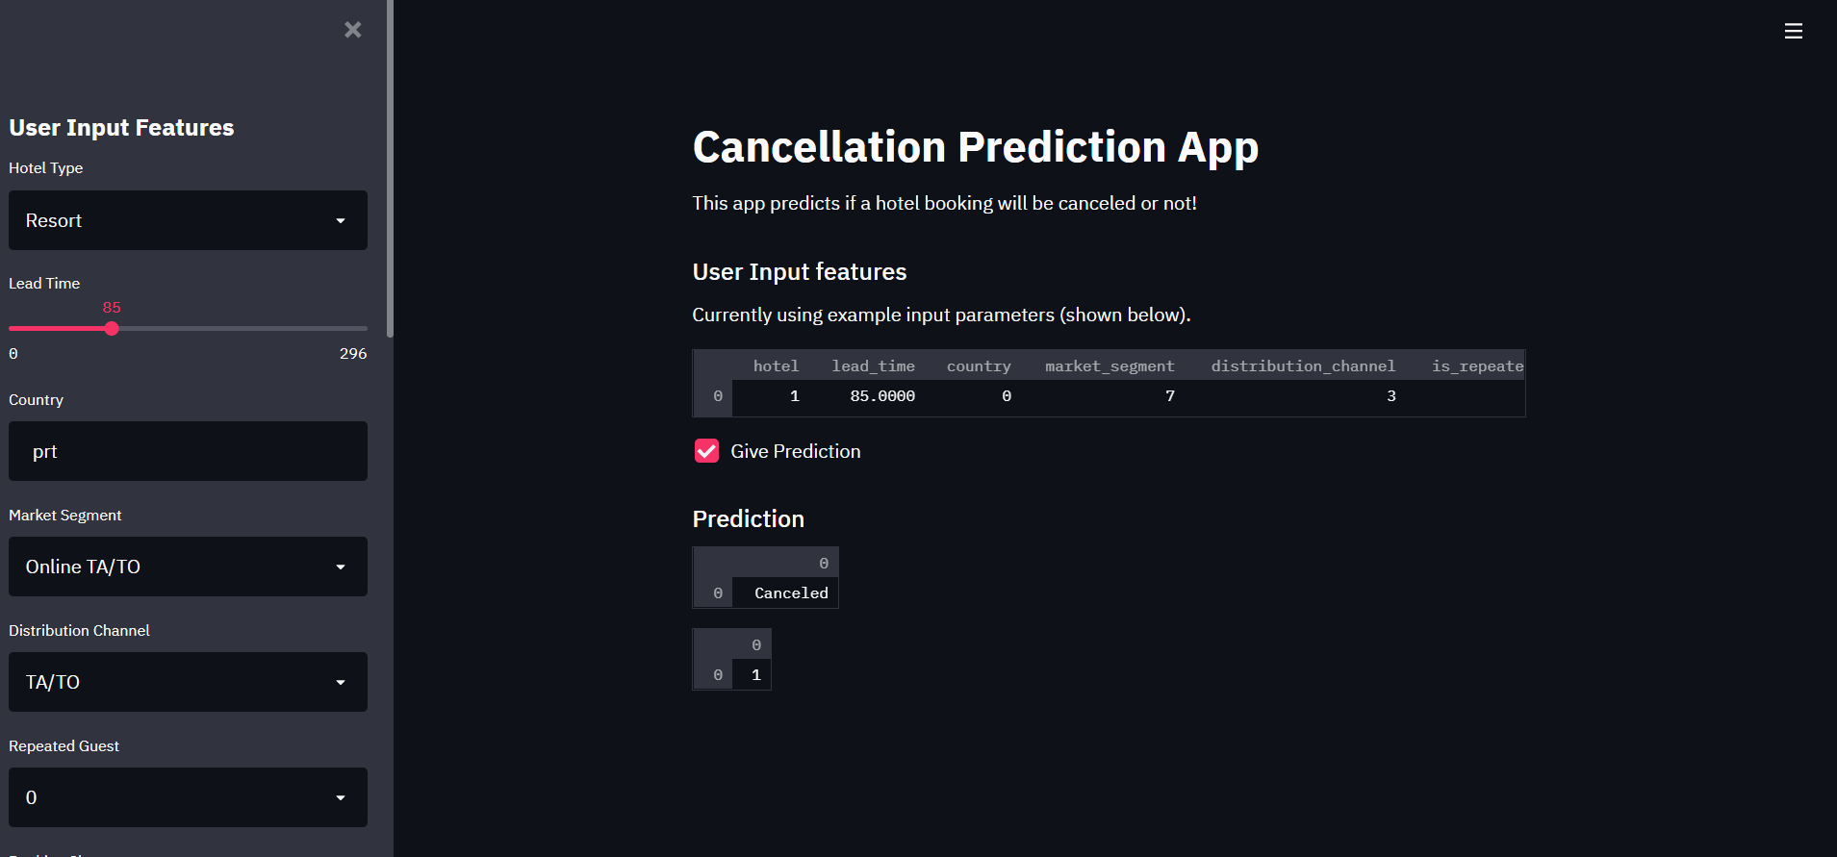
Model Deployment using Streamlit

Slide 32
Challenges Faced -
Target variable “is_canceled” has an imbalanced set of values for the two classes. In order to make the model correctly predict, the imbalance needed to be handled.
We had a variety of models to choose from but running them all was a time consuming and hardware heavy task.
Understanding the different models and the parameters to input in order to make the model better at predicting.
Deploying the model
How Did We Overcome? -
Learning about dataset imbalance through study material and python documentation to figure out oversampling technique was the right one.
Tasks were divided among the teammates so everyone had equal amount of work.
Daily meetings to keep a check on the progress of our project. Weekly meetings with the mentor to get feedback on our work.

Slide 33


